Slide 1
Analysis of Starbucks’ Global Presence

Slide 2
Research Questions
What countries have the most Starbucks locations? What is the store per capita for these countries?
2. Can we infer from this data how Starbucks choose a country in which to operate?
3. What country currently without Starbucks could be a potential for a new location?

Slide 3
What countries have the most Starbucks locations?
2017 Starbucks data from kaggle.com

Slide 4
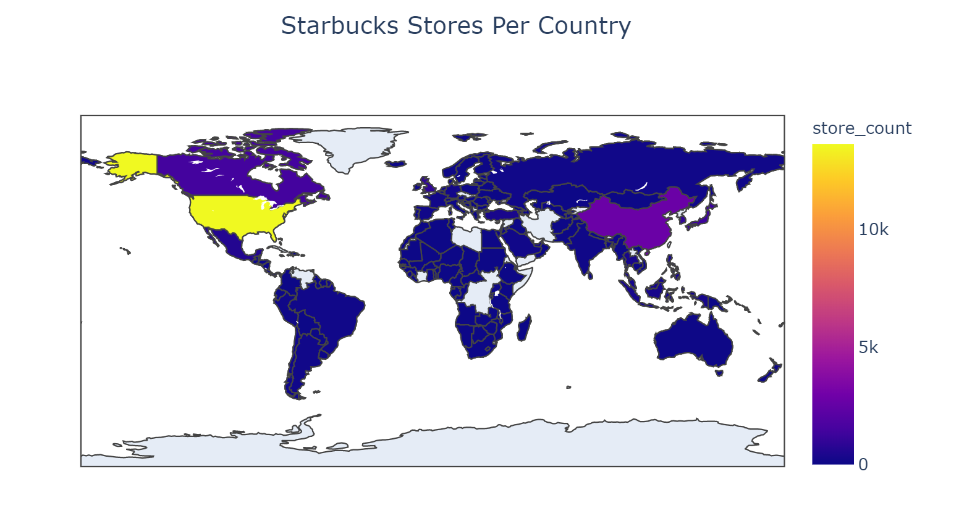

Slide 5
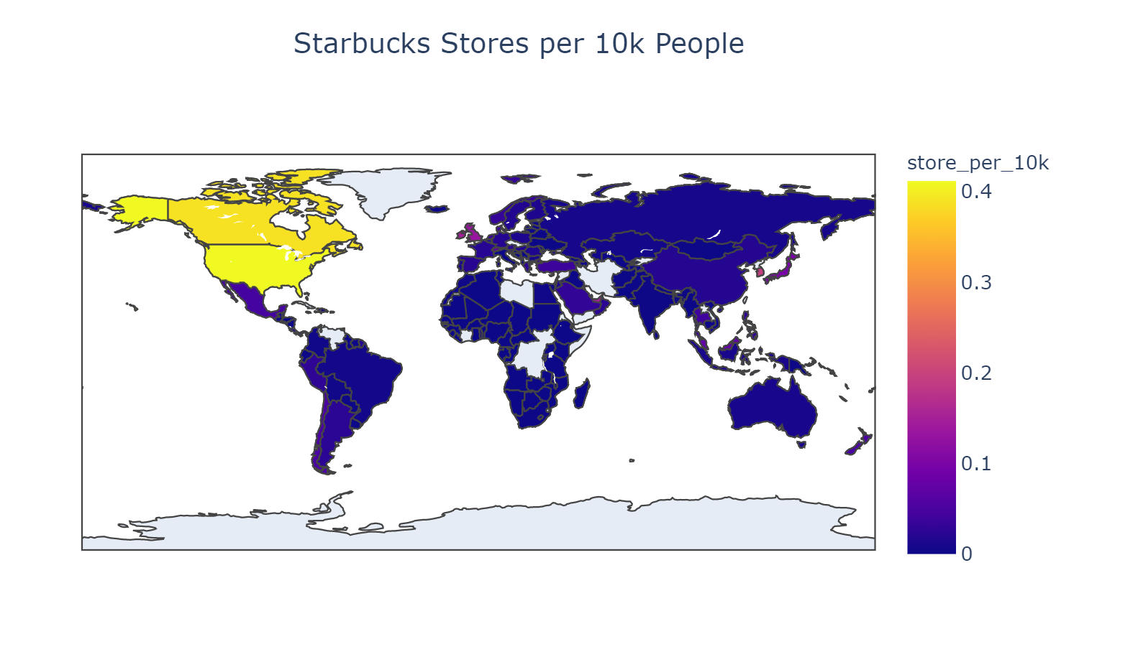

Slide 6
Can we infer from this data how Starbucks chose a country in which to operate?
GDP(PPP) per capita - data from World Bank
Population- data from Worldometer
Ease of doing business- data from World Bank
Coffee consumption - data from ICO

Slide 7
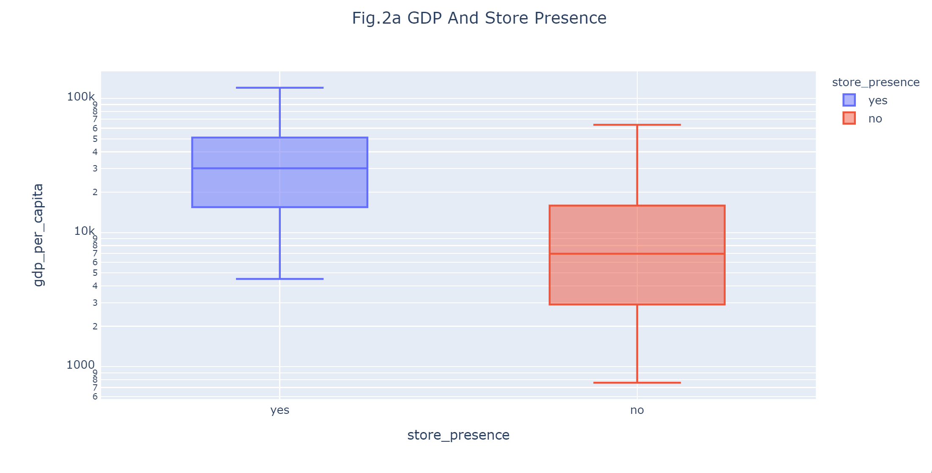
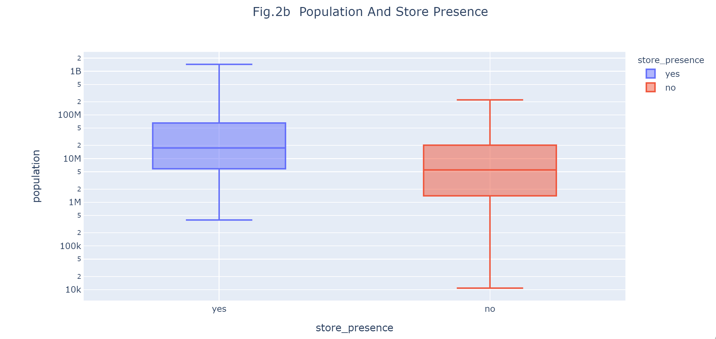
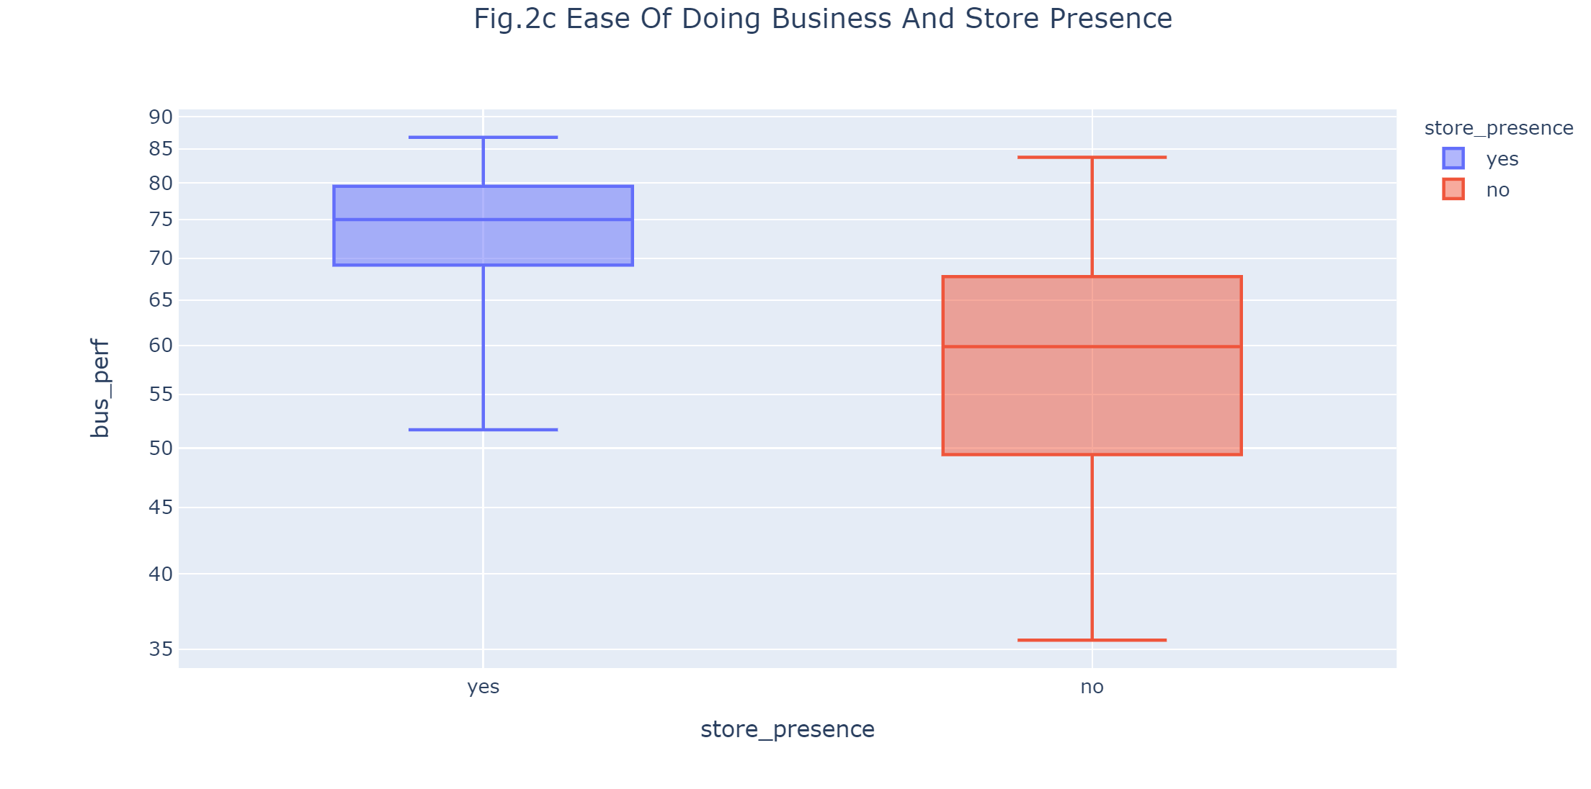
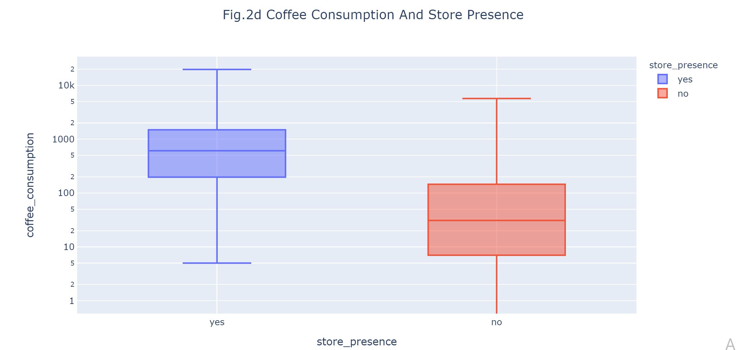

Slide 8
What country currently without Starbucks could be a potential for a new location?

Slide 9
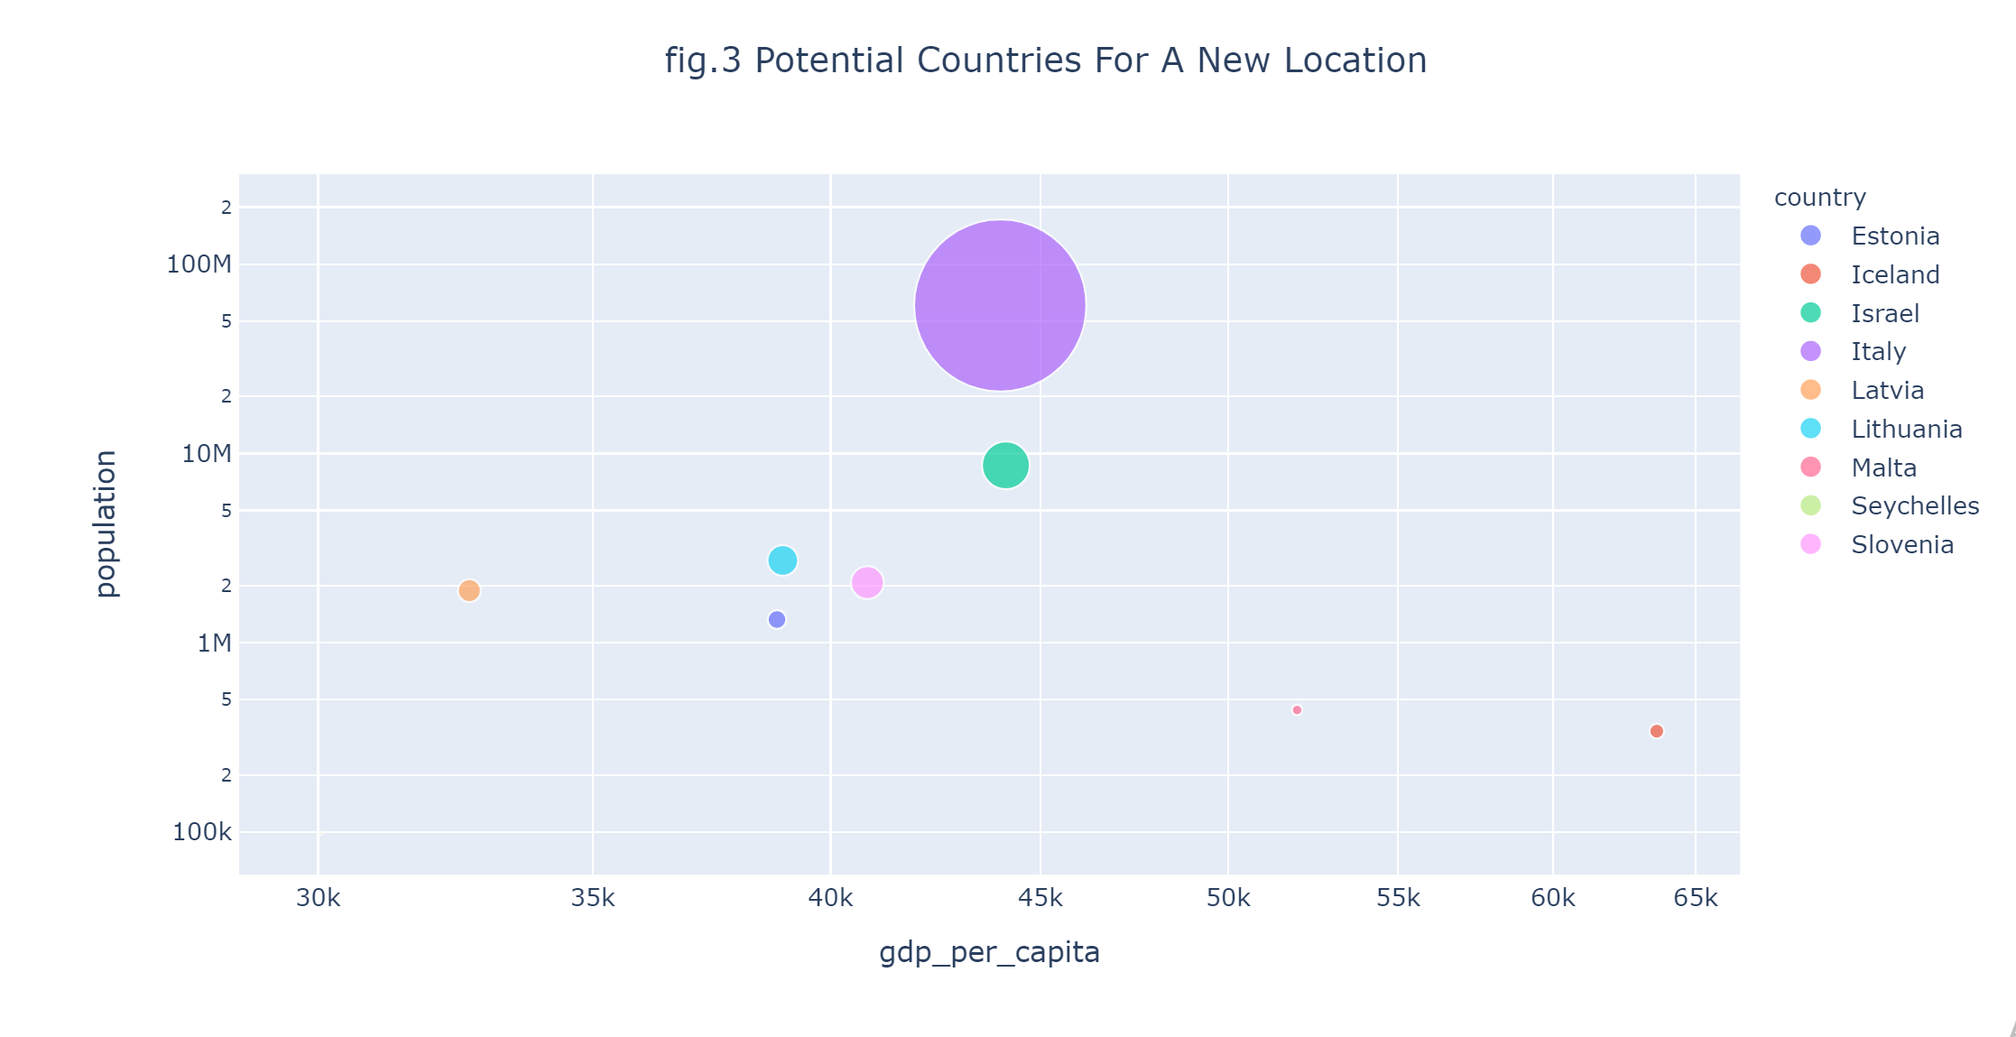

Slide 10
Conclusion
United States has the most Starbucks locations in the world. It is followed by China, Japan, South Korea and United Kingdom. Starbucks is opening more stores in Asia than in Europe and Americas.
Countries with Starbucks stores had GDP per capita(>=30000), population(>=17 million), coffee consumption (610) and business performance(>=74) those were higher numbers compared to countries that didn’t have Starbucks store.
With high GDP per capita , population and coffee consumption , Italy and Israel could be a potential countries to open a new Starbucks location.

